Slide 1
Hospital Analytics Dashboard Power BI Project Anjali Vishwakarma

Slide 2
OBJECTIVE
To analyze hospital data using Power BI
To track patient trends and appointments
To monitor revenue and payments
To support data-driven decision-making

Slide 3
DATASET OVERVIEW
Patients Table – patient details
Doctors Table – doctor information
Appointments Table – visit details
Billing Table – revenue & payment data
Treatments Table – treatment cost analysis
Tables are connected using relationships

Slide 4
KPIs
Total Patients
Total Revenue
Total Appointments
Completed Appointments
Pending Payments
These KPIs provide a quick overview of hospital
performance

Slide 5
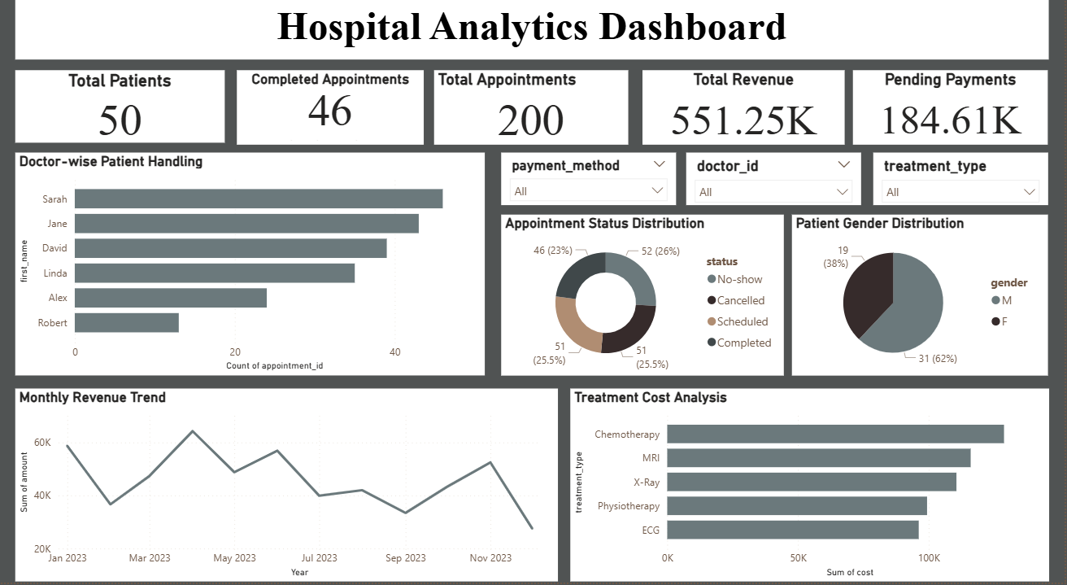

Slide 6
KEY INSIGHTS
Most appointments are successfully completed
Revenue varies across different months
Some doctors handle more patients than others
Certain treatments contribute more to overall cost
Gender distribution is balanced

Slide 7
CONCLUSION
Provides clear insights into hospital operations
Helps in analyzing patient trends and performance
Supports better decision-making
Improves efficiency and planning

